Slide 1
Technical Aspects Of Poster Production
Presented by Gareth Cowan
Date 23/01/2013

Slide 2
Printing Process
Setup Page Settings
Create Poster and Save As PDF
Print A3 Draft From CM131 (10mins)
Verify Draft and Collect Poster (5Days)

Slide 3
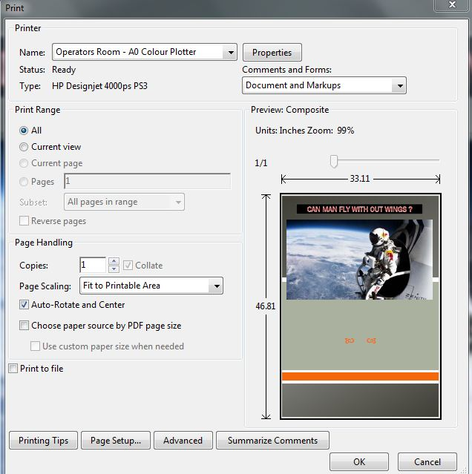
Printer Settings

Slide 4
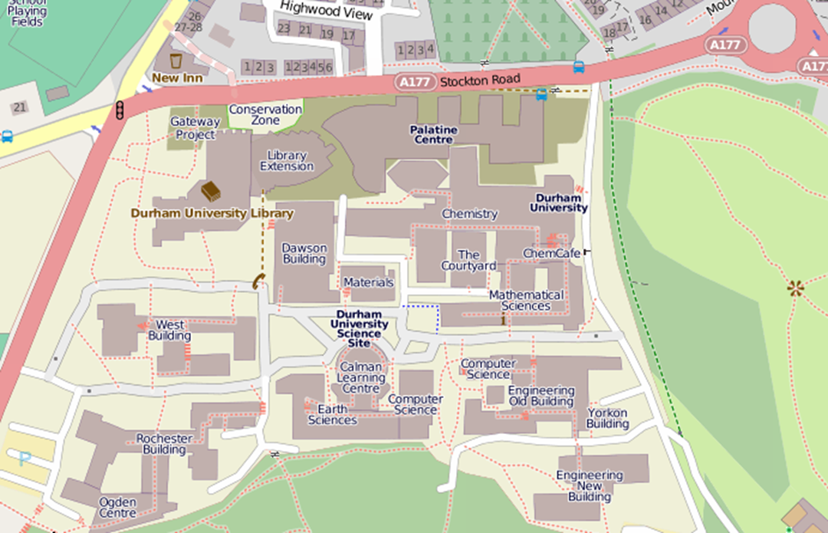
Where – CM131, CM001, CM003

Slide 5
Cost of Printing A2
Paper type | Cost per metre | Printer Credits
Heavyweight paper | £1.25 | 31
High-gloss photo paper | £2.50 | 62
A2 Portrait Width – 42.1 cm Height 59.4 cm
A2 Landscape Width – 59.4 cm Height 42.1 cm

Slide 6
Guide Link
https://www.dur.ac.uk/cis/docs/
Search for : A0 printer

